Slide 1
NFL Rookie Salary Guide
ECO 590
McKenna Moore

Slide 2
Motivation
The Superbowl is consistently the most watched primetime event on cable television and playing in the Superbowl comes not only with a title but also with a hefty bonus
Spotrac.com is a sports database that gathers varying salary’s in sports stating with when a player enter any professional league
I am interested in studying varying factors that maximize a rookie’s initial salary when they enter the NFL including the implementation of new salary guidelines and the team a rookie signs with

Slide 3
Research Questions
Does the length of a contract and the team a rookie signs to have an effect on total contract value?
How did the 2011 CBA effect average contract factors effect contract values when a player enters the NFL? What other draft and contracts factors effect total contract value?

Slide 4
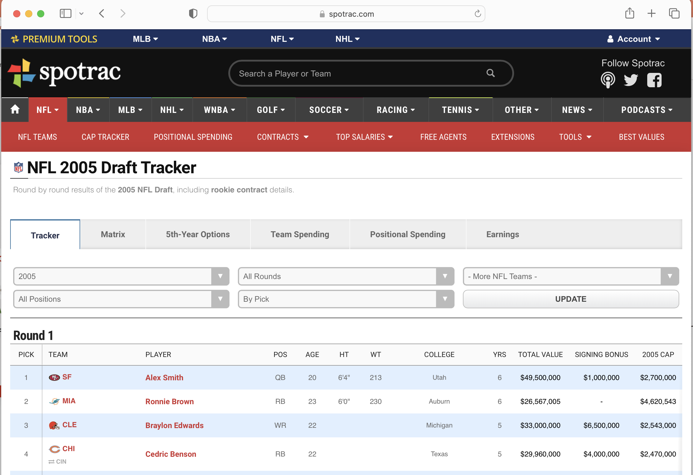
Webscraping Spotrac

Slide 5
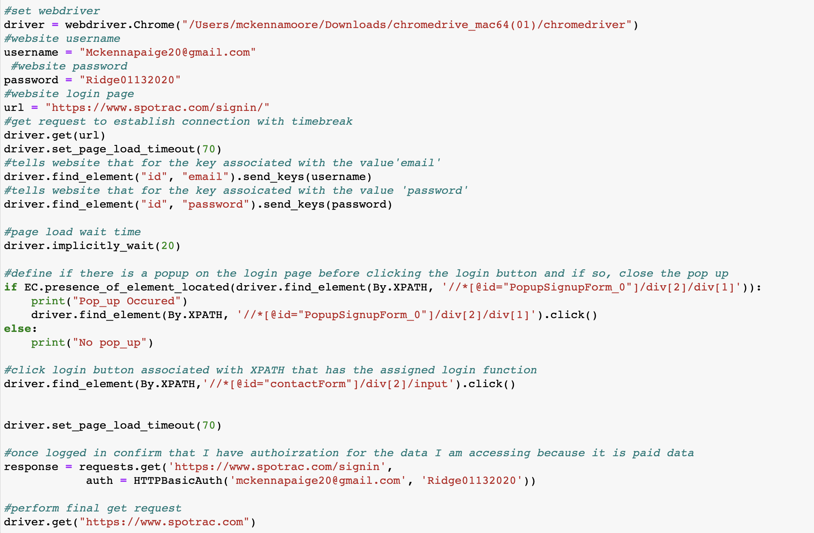
Challenge in Web-Scraping: using a webdrvier to establish connection

Slide 6
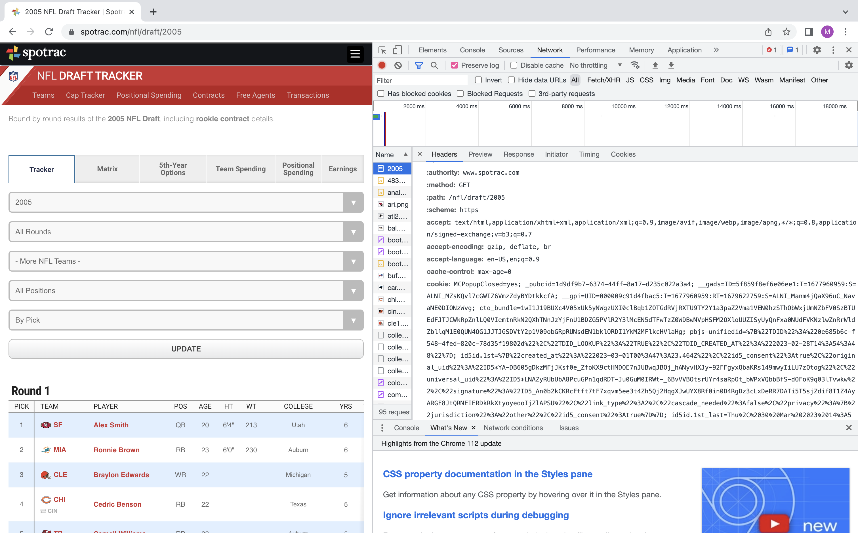
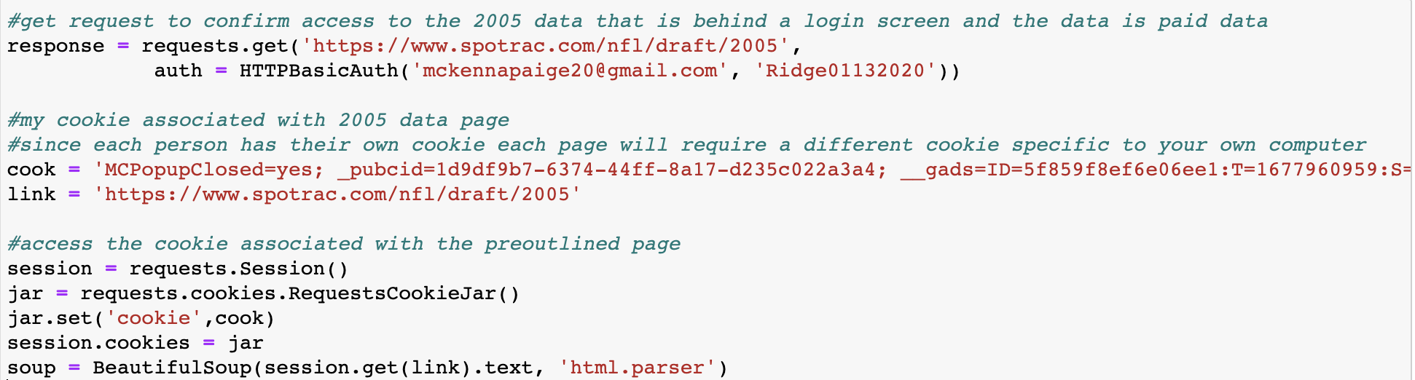
Challenge in Web-Scraping: using cookies to access data

Slide 7
Key Variables Web-scraping Spotrac.com
Player name: key for merging to dataframes together
Position: does position have an effect on salary
Age: key for merging to dataframes together
Team: Associated with different yearly salary caps
College: Associated with division
Years: Contract length
Salary Variables

Slide 8
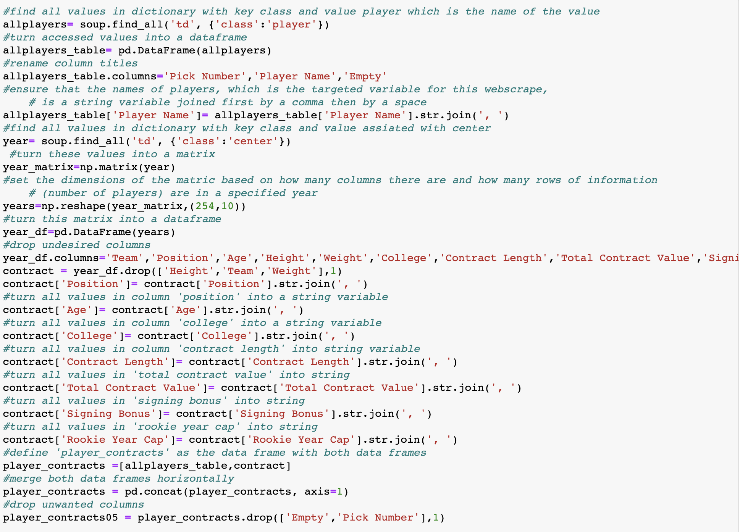
Sample webscrape for one year

Slide 9
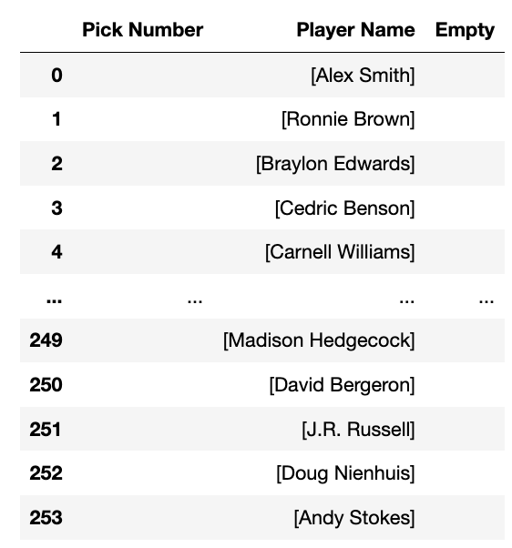
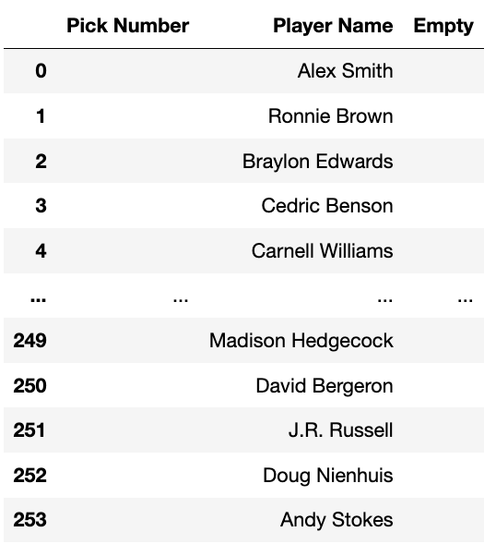
Sample cleaning of player names

Slide 10
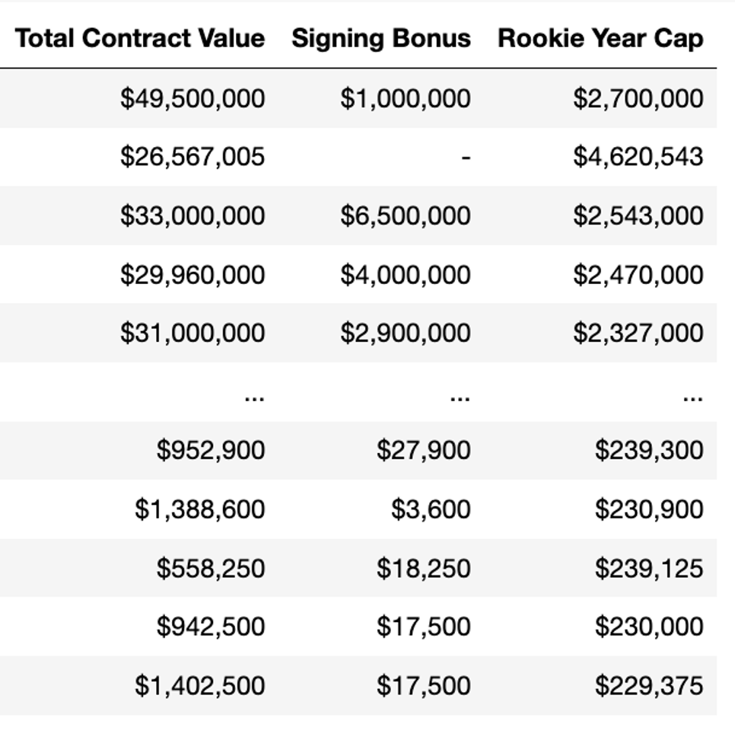
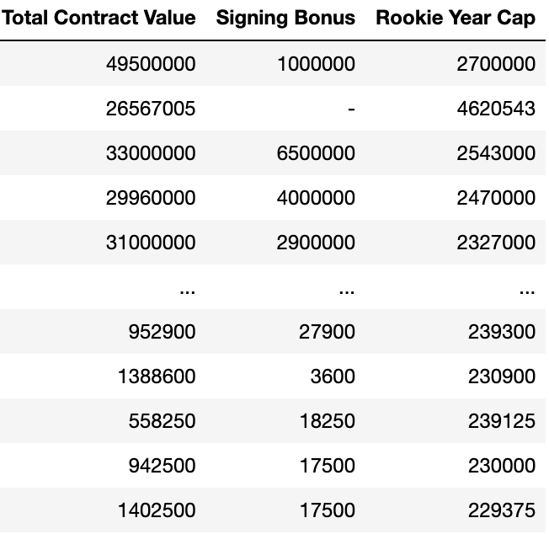
Challenge in Web-Scraping: Cleaning Salary Information

Slide 11
Challenge in Web-Scraping: Cleaning Salary Information
allcontracts['Total Contract Value'] = allcontracts['Total Contract Value'].str.replace( ',', '').str.replace('$', '')
allcontracts['Signing Bonus'] = allcontracts['Signing Bonus'].str.replace(
',', '').str.replace('$', '')
allcontracts['Rookie Year Cap'] = allcontracts['Rookie Year Cap'].str.replace(
',', '').str.replace('$', '')

Slide 12
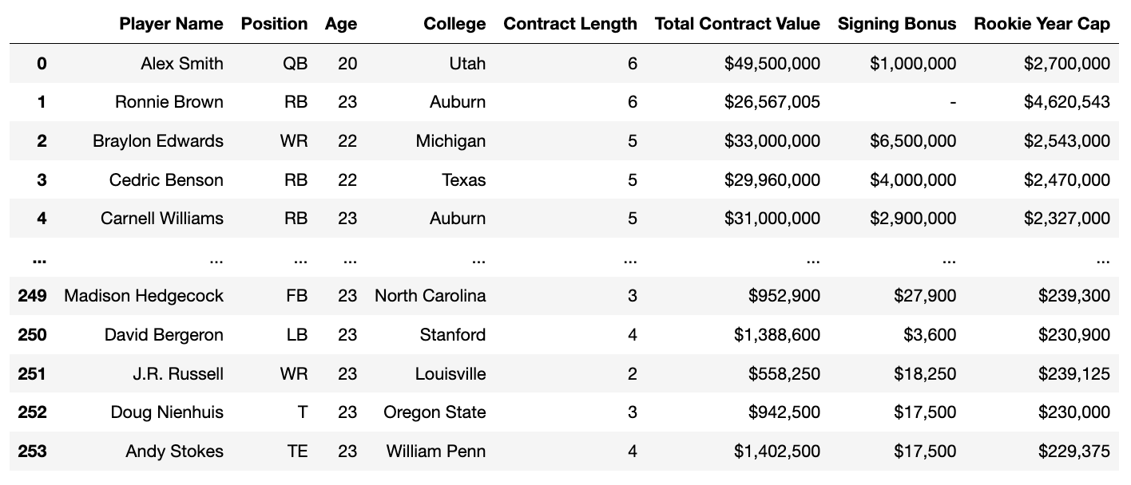
Output of full webscrape for one year

Slide 13
Merging Dataframes
Merging the yearly information dataframes:
webscrape = pd.concat([player_contracts17, player_contracts16, player_contracts15, player_contracts14, player_contracts13, player_contracts12, player_contracts11, player_contracts10, player_contracts09, player_contracts08, player_contracts07, player_contracts06, player_contracts05], axis=0, ignore_index=True)
Import external information and turning it into a dataframe
Draft = pd.read_csv('AllDrafts.csv', sep=',', header=0, dtype=str)
Merge both dataframes on shared column titles
allcontracts = pd.merge(Draft, webscrape, on=['Player Name','Position','College','Age', 'Contract Length'])
allcontracts.to_csv('allcontracts.csv')

Slide 14
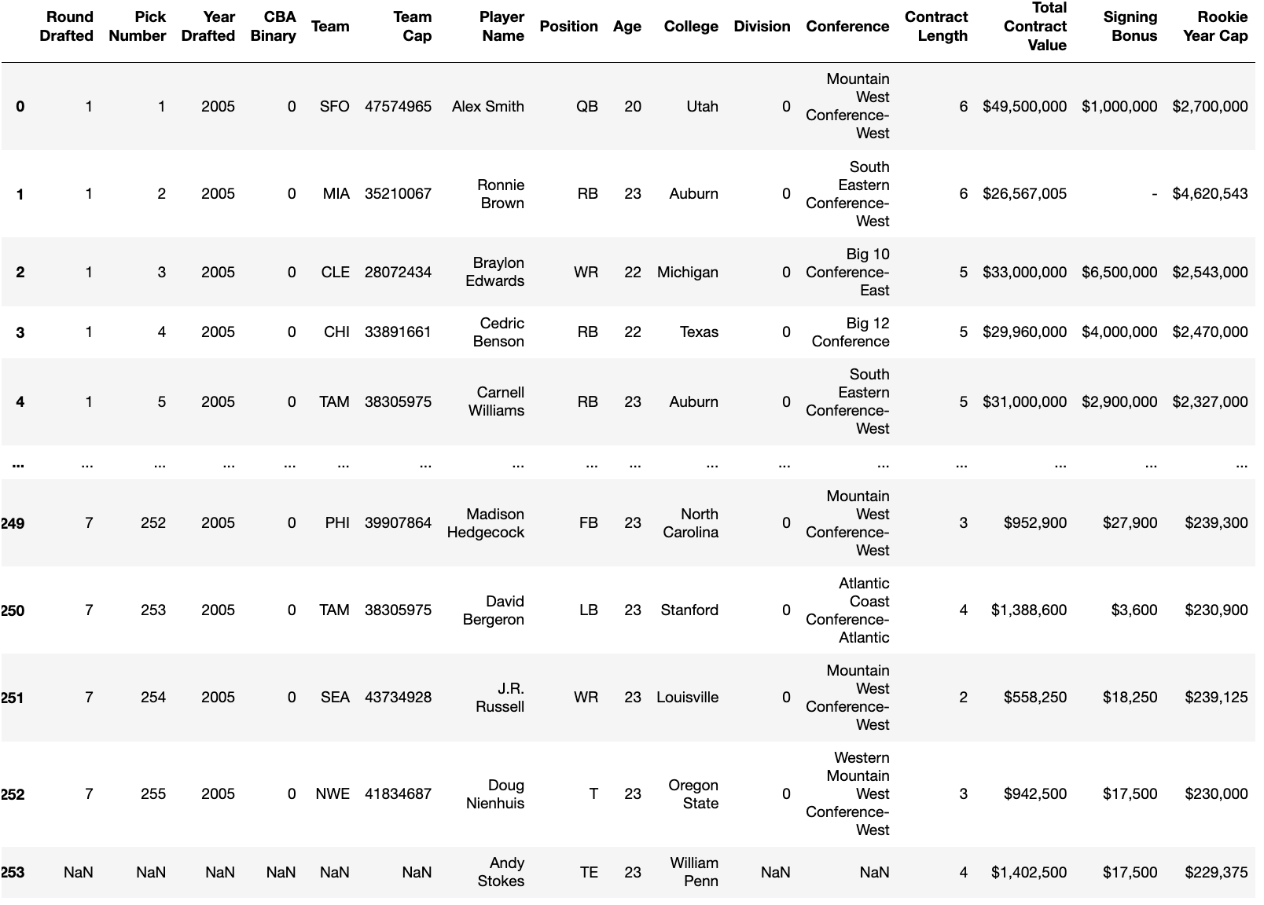

Slide 15
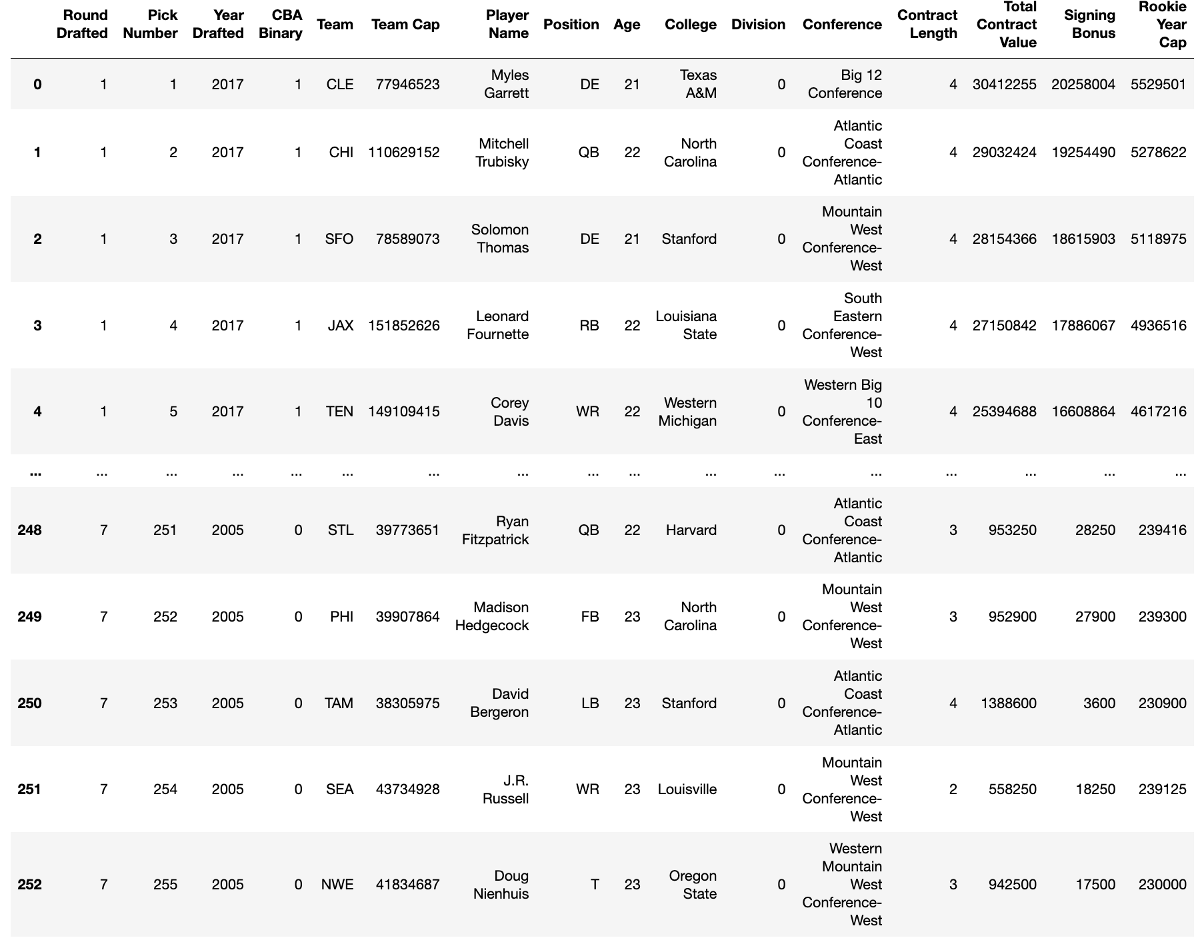

Slide 16
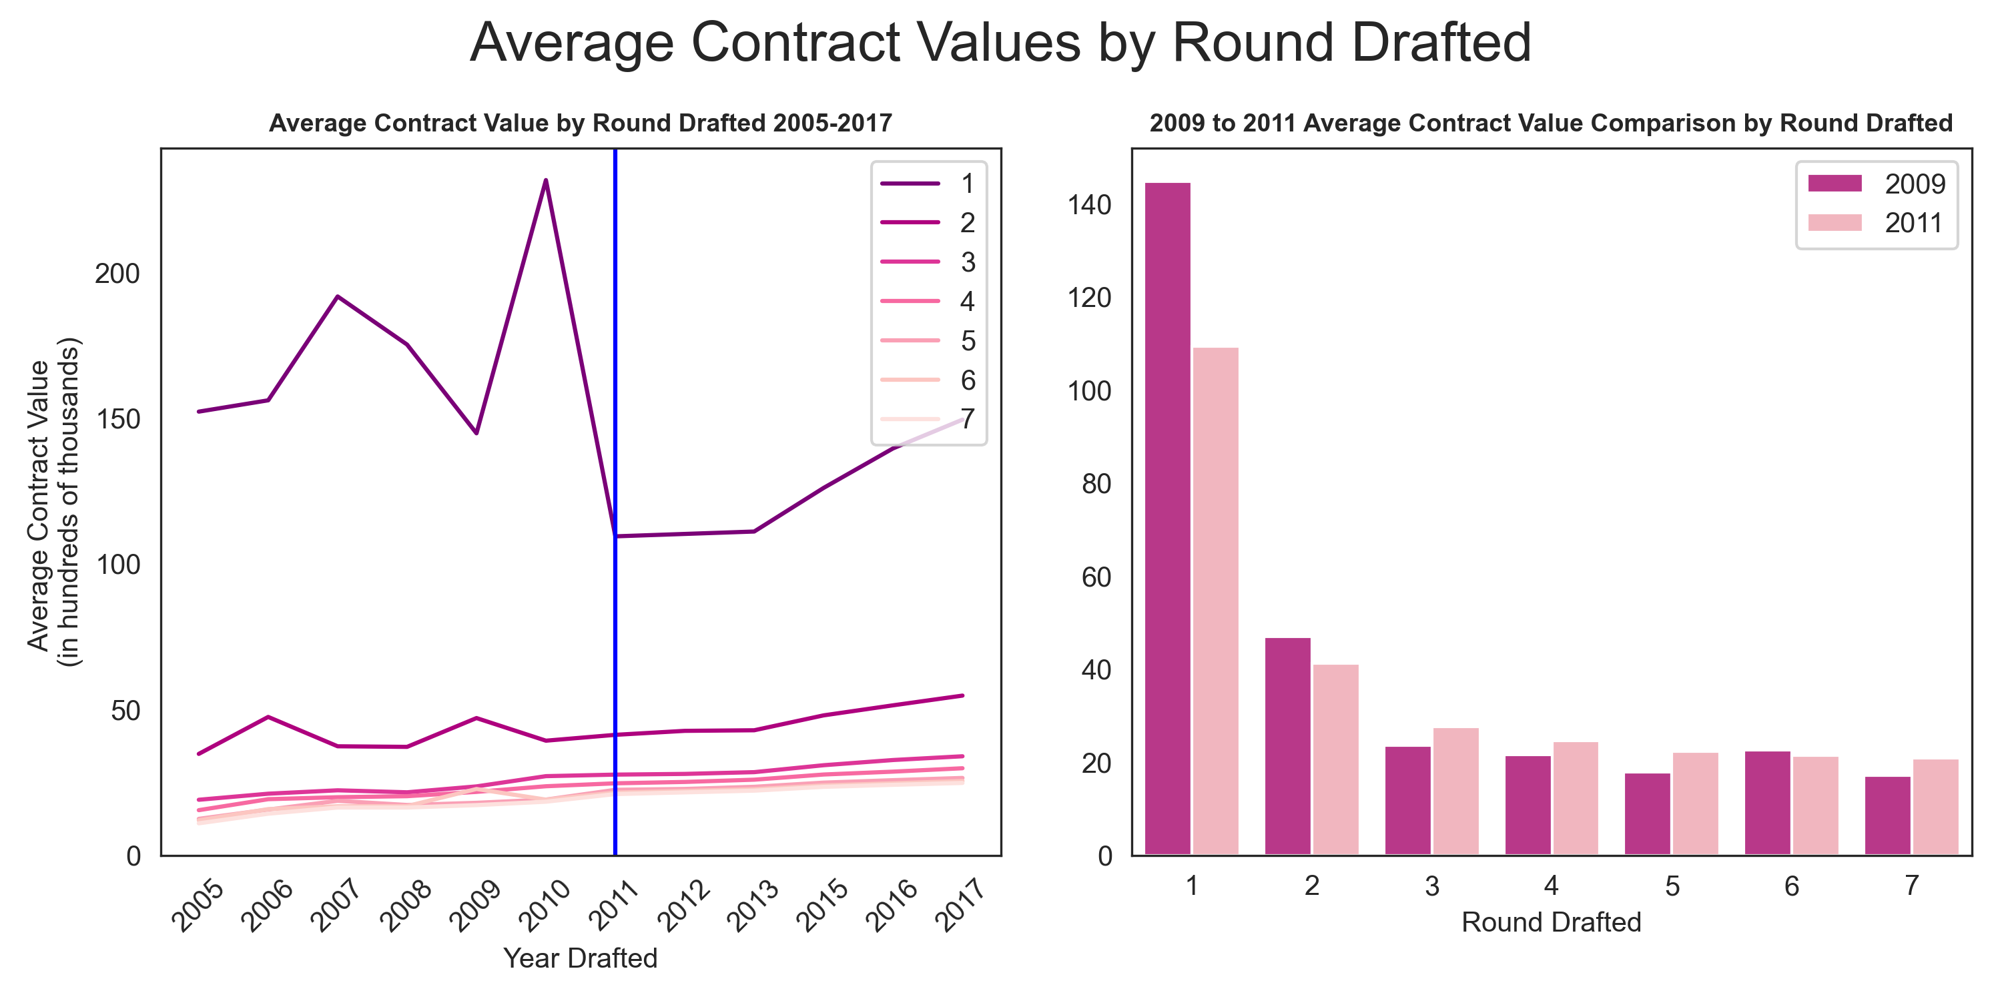

Slide 17
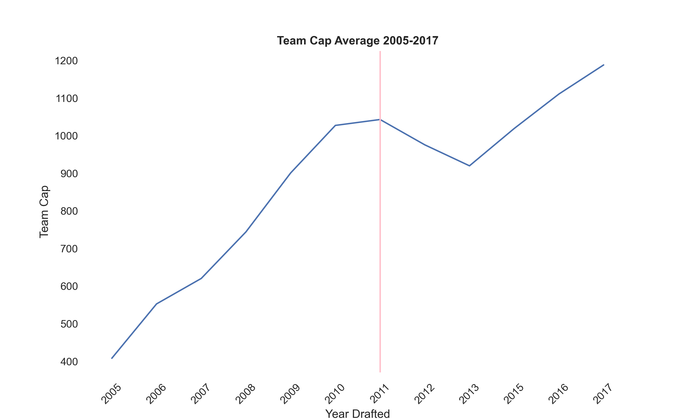

Slide 18
Models
Base Model:
Log_TotalValue = β₁(log_TeamCap)_{i} + β₂(CBABinary)i + μ
Robust Standard Errors:
Log_TotalValue = β₁(log_TeamCap)i + β₂(CBABinary x RoundDrafted)_{i} + ΦZ_{i} + μ
where Zi represents model controls Role, YearDrafted, Age, Length, and Division
Feasble Generalized Least Squares:
Log_TotalValue = β₁(log_TeamCap)i + β₂(CBABinary x RoundDrafted)_{i} + ΦZ_{i} + μ ,
weights = model.residuals
where Zi represents model controls Role, YearDrafted, Age, Length, and Division

Slide 19
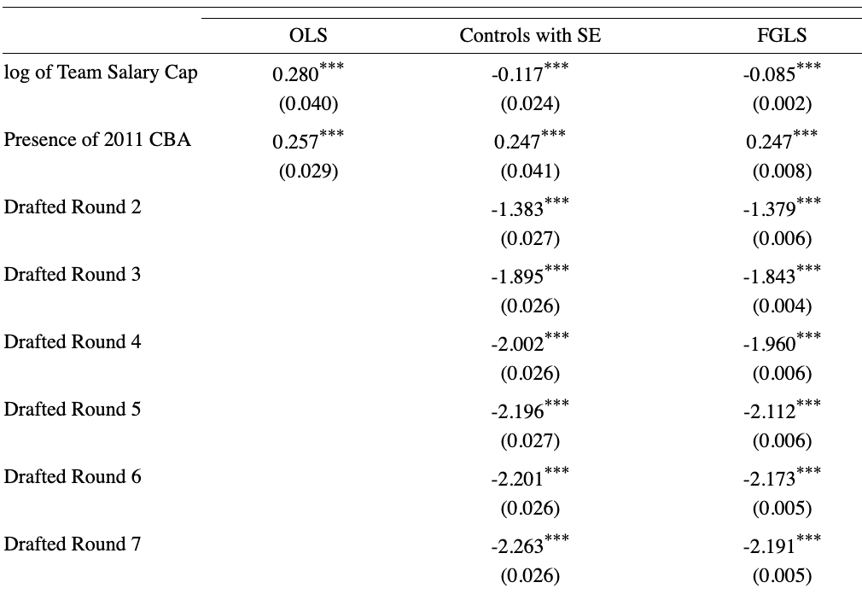
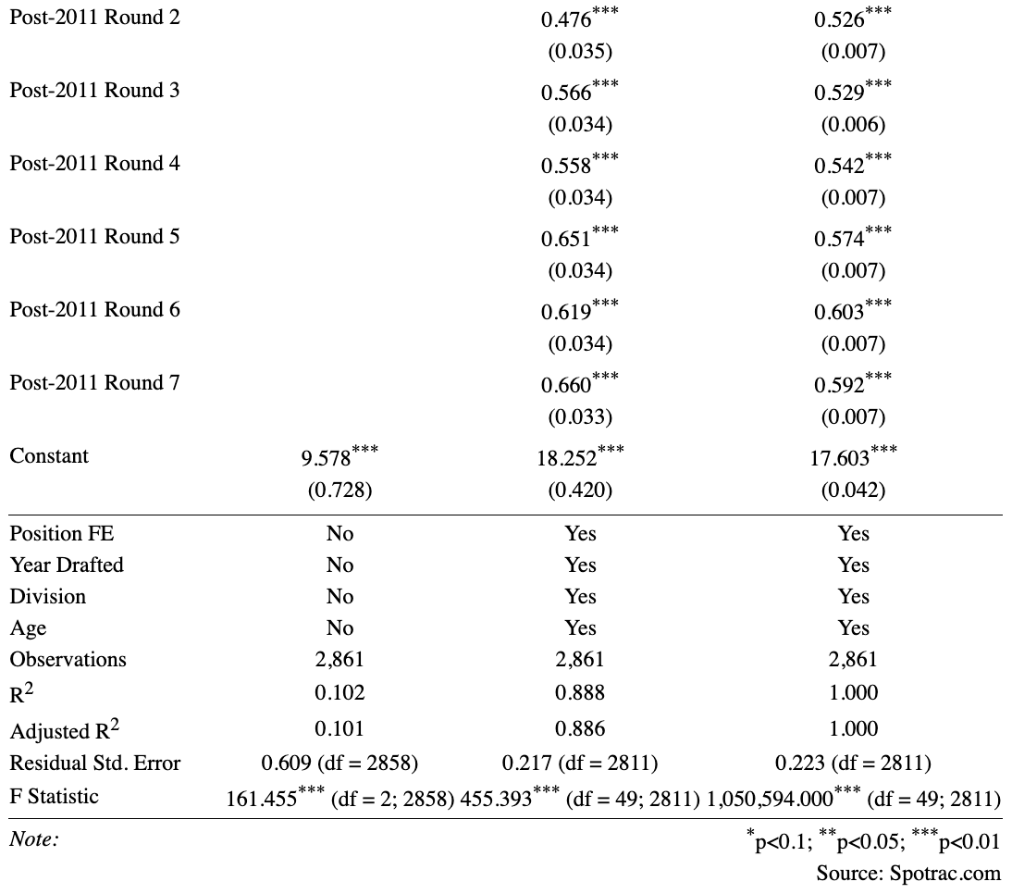

Slide 20
Discussions
My first attempt at controlling for heteroskedasticity was using robust standard errors on my OLS model.
The log of team salary cap states that for every 1% change in team salary cap, the total value of a rookie's contract will decrease by 0.117%.
The Presence of 2011 CBA variable indicates that if a candidate has the variable, or they are drafted after the implementation for the 2011 CBA, their rookie contract will by 0.247% higher than those without the variable.
The interaction between round drafted and the CBA decreases the negative effect that not being drafted in the first round has on your salary. Pre-2011 round 2 salary decreases by 1.383%. The additional marginal affect of being drafted after 2011 in round 2 is 0.907% increase relative to the round 1 reference.

Slide 21
Discussions
My preferred model is my FGLS model because it controls for heteroskedasticity stemming from the residuals in my third OLS model.
The log of team salary cap states that for every 1% change in team salary cap, the total value of a rookie's contract will decrease by 0.085%.
The Presence of 2011 CBA variable indicates that if a candidate has the variable, or they are drafted after the implementation for the 2011 CBA, their rookie contract will by 0.247% higher than those without the variable.
The interaction between round drafted and the CBA decreases the negative effect that not being drafted in the first round has on your salary. Pre-2011 round 2 salary decreases by 1.379%. The additional marginal affect of being drafted after 2011 in round 2 is 0.853% increase relative to the round 1 reference.

Slide 22
Conclusion and Future Study
The presence of the 2011 CBA has a great effect on decreasing the impact of not being drafted in the first round
Increase in team salary cap has a negative effect on individual salary
Assuming this is because the CBA decreased individual compensation
Greatest effect of CBA is presented in candidates drafted in later rounds

